Slide 1
Online Learning Impact analysis
Submitted in the partial fulfillment for the award of the degree of
BACHELOR OF ENGINEERING
IN COMPUTER SCIENCE WITH SPECIALIZATION IN BIG DATA ANALYTICS
Submitted by:
RAJ SINGH 22BDA70035 ANMOL RANA 22BDA70032 GAUTAM SINGLA 22BDA70030 SIDHARTH PUNDIR 22BDA70006
Under the Supervision of:
DR. AMARDEEP SINGH
Department of AIT-CSE
DISCOVER . LEARN . EMPOWER

Slide 2
Problem Statement & Objectives
Problem Statement
Online learning environments often result in:
Frequent task switching
Short fragmented sessions
Heavy replay dependency
Reduced focus stability
There is no standardized behavioral metric to detect at-risk learners early.
Objectives
Develop Learning Fragmentation Index (LFI)
Develop Replay Dependency Phenomenon (RDP)
Analyze correlation with learning effectiveness
Implement risk classification model
Build interactive Power BI dashboard

Slide 3






System Architecture
Data Storage
Data Collection
Data Processing & Risk Classification
Google Forms
Google Sheets
Python
Visualization
Pandas
NumPy
Power BI

Slide 4
Methodology
Data Collection
80 students
Behavioral + Outcome + Demographic data
Risk Classification
Condition | Risk
LFI < 0.65 & RDP < 0.60 | Low
One above threshold | Moderate
Both above threshold | High
Index Computation
LFI = Average of 6 fragmentation variables RDP = Average of 5 replay variables

Slide 5
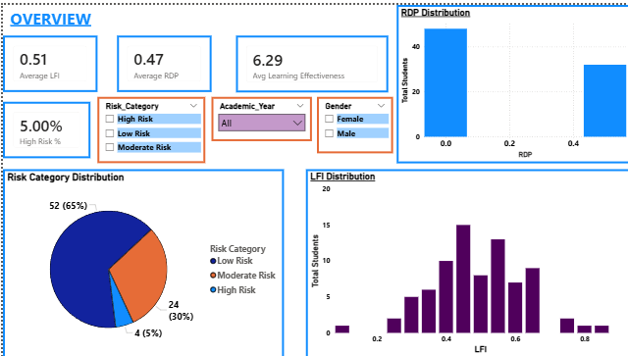
Overview Dashboard Results
Key Metrics
Average LFI = 0.51
Average RDP = 0.47
Average Learning Effectiveness = 6.29
High Risk Students = 5%
Risk Distribution
65% Low Risk
30% Moderate Risk
5% High Risk
Interpretation: Majority stable, but measurable vulnerable group exists.

Slide 6
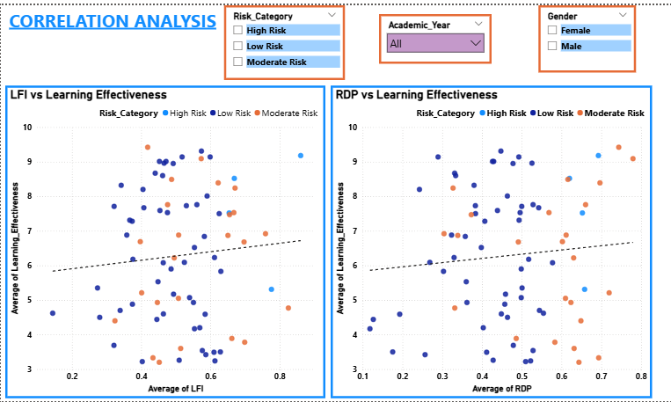
Correlation Analysis
Findings
LFI vs Learning Effectiveness Slight Negative Correlation
RDP vs Learning Effectiveness Moderate Negative Pattern
LFI vs RDP Moderate Positive Relationship
Conclusion: Higher fragmentation and replay dependency reduce effectiveness.

Slide 7
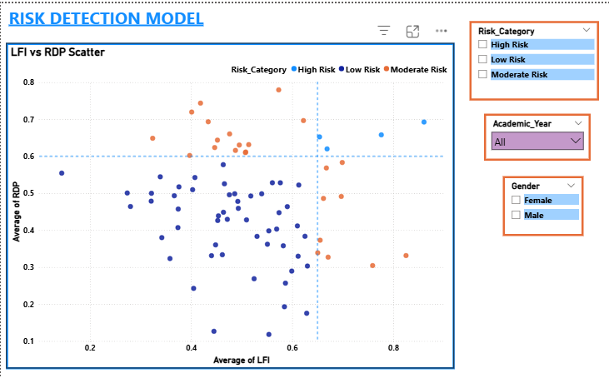
Risk Detection Model & Demographics
Quadrant Model
Top Right → High Risk
Bottom Left → Low Risk
Mixed → Moderate Risk
Demographic Insights
Variation across Academic Years
Gender-based LFI differences
Behavioral progression patterns

Slide 8
Results & Conclusion
Results Achieved
Developed measurable behavioral indices
Implemented dual-threshold classification
Validated correlation with effectiveness
Created fully functional interactive dashboard
Conclusion
Fragmentation negatively impacts learning
Replay dependency reflects cognitive difficulty
Dual-index model improves risk detection
System can serve as institutional early-warning framework
Thank You

